Slide 1
IFTA, Inc. Financial Report
Scott Bryer (NH)
1st Vice-President, IFTA Board of Trustees

Slide 2
Funds Netting Totals
Notes:
On pace to exceed $5 Million transmitted in 2019

Slide 3
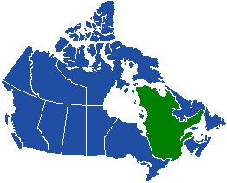
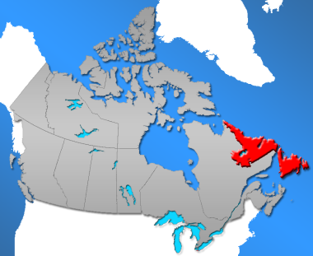
Clearinghouse Participation
56 jurisdictions participate in the IFTA Clearinghouse.
Quebec anticipates joining the Clearinghouse in 2020.
We will work with Newfoundland Labrador toward Clearinghouse participation.

Slide 4
IFTA Inc. Revenues

Slide 5
IFTA, Inc. Expenses

Slide 6
FYE20 Revenue Projections
Membership Dues and IRP ARES stable
Dispute Resolution Referral Fees ended
2.5% Return on Investments projected
Funds Netting Liquidity
Plus One Traveler Explicit Transfers from Investments

Slide 7
FYE20 Expense Projections
Salaries overall decrease, benefits cost increase
Professional Services decrease
Legal Fees increase to retain outside counsel
Office Expenses increase due mostly to Clearinghouse co-location
Travel increase due to remote workforce and greater outreach
Notes:
Professional Services decrease due to no SOCII audit and no Strategic Plan expense

Slide 8
Investment Portfolio

Slide 9
Investment Reserves

Slide 10
IFTA, Inc. Audits
Financial Audit
SOC II Audit

Slide 11
What’s New?
Liquidity Investment of Funds Netting Funds (Government Securities only)
Plus One traveler re-approved
All servers moved to a secure co-location
Preparations underway to vacate office in August, 2020

Slide 12
FYE20 IFTA, Inc. Budget

Slide 13
QUESTIONS?

